Slide 1
Dog Breed Choice: A Predictive Analysis of Dog Ownership in Zurich, Switzerland
Descriptive Statistics and Data Modelling
Sergio Guidon, 12/11/2024

Slide 2
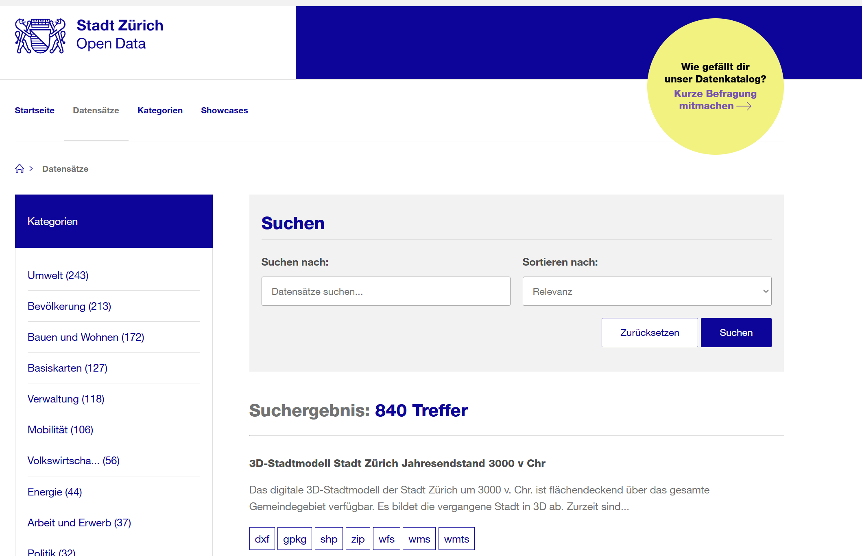
Zurich’s Open Data Portal allows analysts to access a wide variety of interesting datasets
Data Source: Dog Population
Metadata such as responsible agency, period, update frequency, etc.
Attribute descriptions
Data in easily accessible formats such as CSV
General link: https://data.stadt-zuerich.ch/
Dog data: https://data.stadt-zuerich.ch/dataset/sid_stapo_hundebestand_od1001

Slide 3
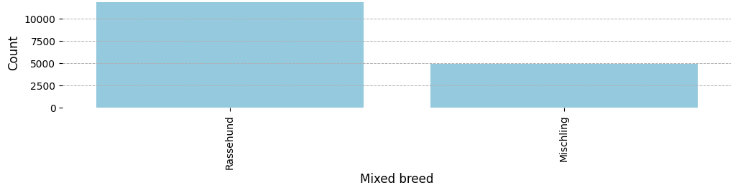
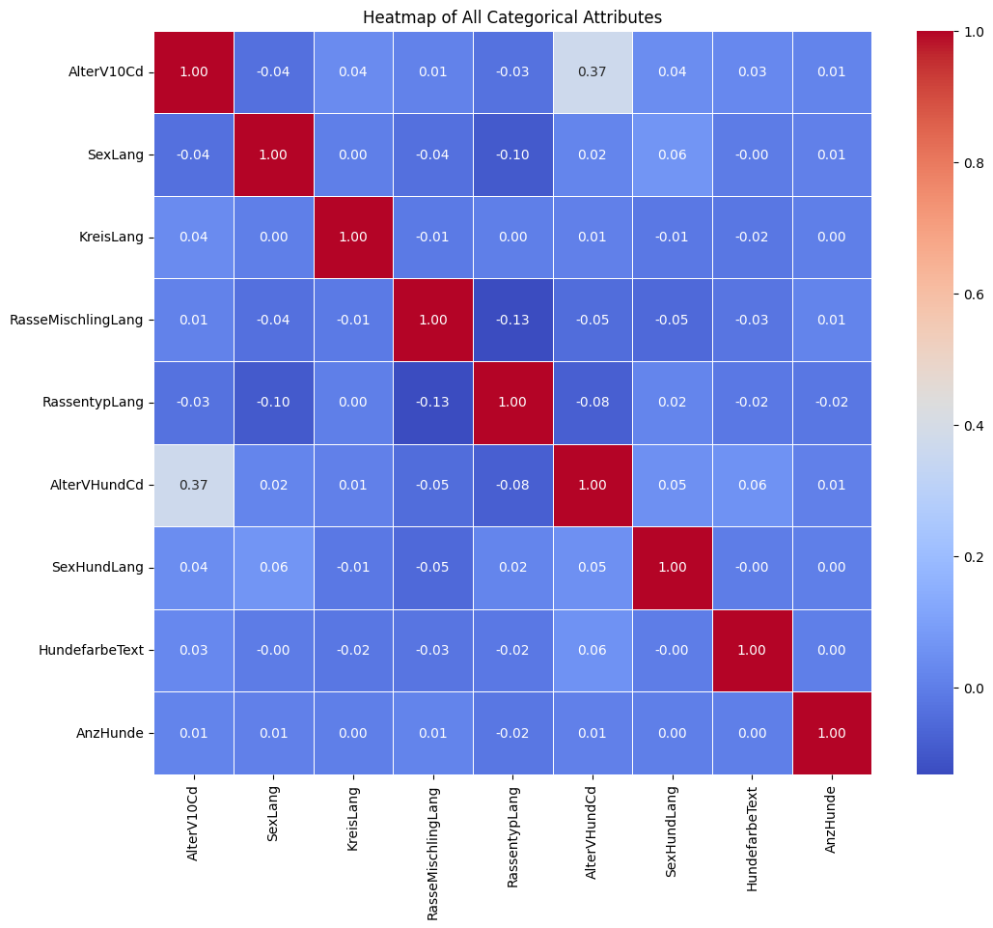
Goal: Predicting Breed (Purebred or Mixed) Based on Available Features
Categories and Features
Labels / Categories
RasseMischlingLang: Mixed breed
Features (selection)
AlterV10Cd: Owner age code
SexLang: Owner gender
KreisLang: District name
Rasse1Text: "Dog breed 1
RassentypLang: Breed type
AlterVHundCd: Dog age in years
SexHundLang: Dog gender
HundefarbeText: Dog color
AnzHunde: Number of dog

Slide 4
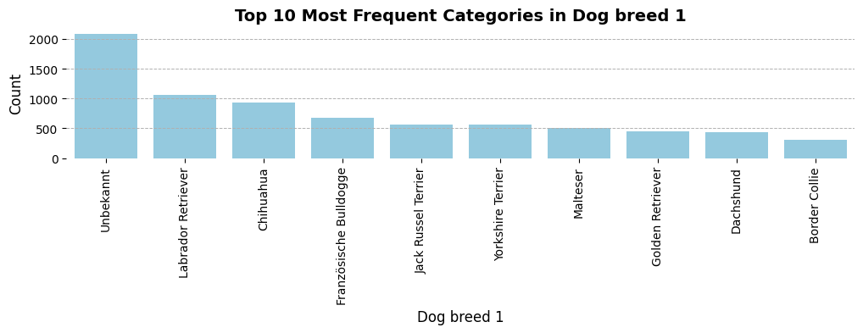
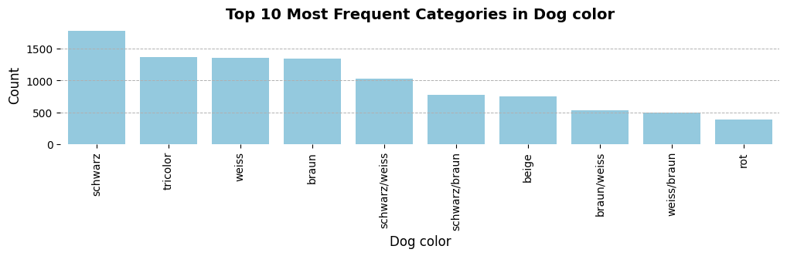
EDA Insights: Zurich's Most Common Purebred - Labrador Retriever; Most Frequent Color - Black
Insights: Color and Breed
Most dogs in the city of Zurich are of unknown breeds.
The Labrador Retriever and the Chihuahua are the most common purebred dogs.
There is a wide variety of breeds, including rarer ones like the Scottish Deerhound.
Consequently, the number of categories needs to be reduced for modelling

Slide 5
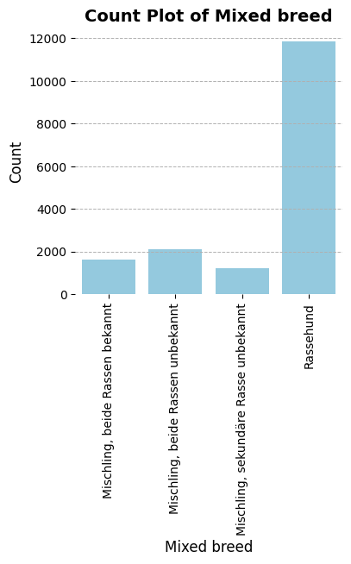
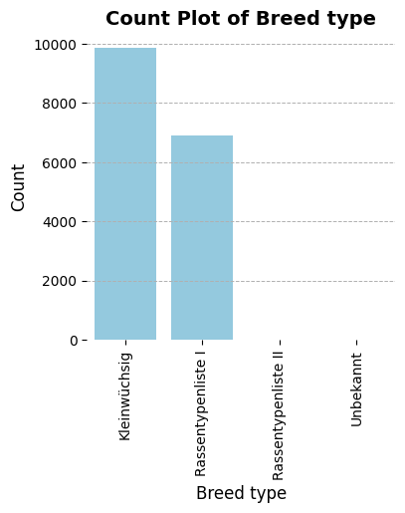
EDA Insights: Pooling Dog Breed Categories for the Analysis
Insights: Breed Type
Most dogs in Zurich are purebred.
There are three categories of mixed-breed dogs that will be pooled for the analysis.
“Kleinwüchsig” refers to small dogs, while breed types I and II represent large and high-risk dogs, respectively (with very few type II dogs). Types I and II will be pooled, and unknown breeds will be filtered out for the analysis.

Slide 6
Features After Feature Engineering
Insights: Correlation Analysis
Removed irrelevant and redundant features.
Some categorical features are weakly correlated:
`AlterV10Cd` and`AlterVHundCd`
`RasseMischlingLang` and `RassentypLang`
`RasseMischlingLang` and `SexLang`
The Variance Inflation Factor (VIF) does not indicate (multi-)collinearity for the numerical variables.

Slide 7
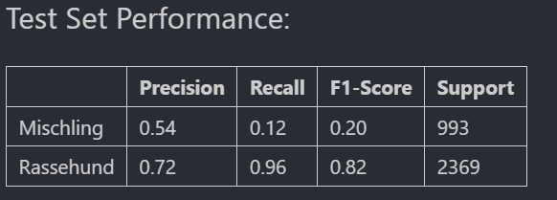
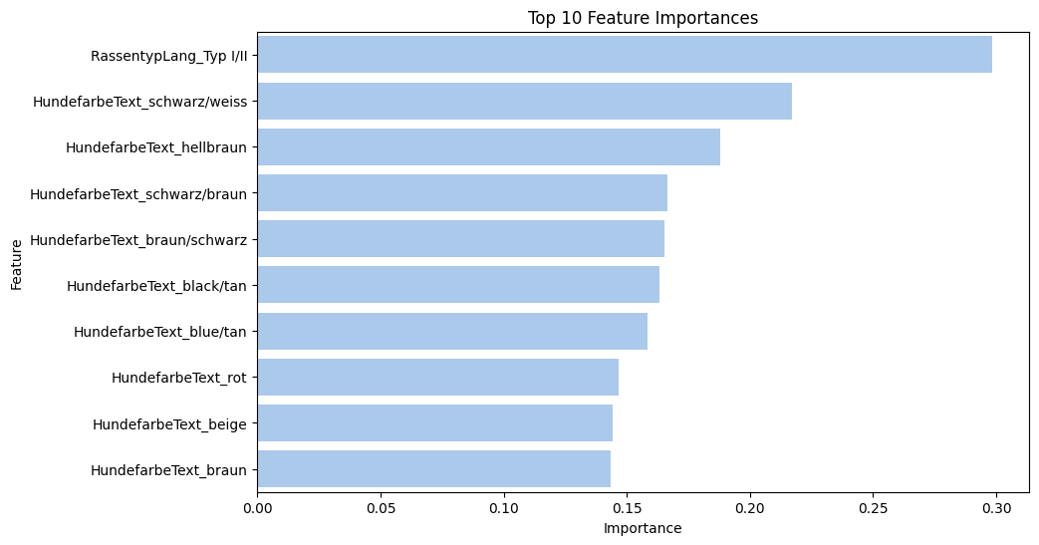
Model 1: Logistic Regression
Log. Reg: Modelling Approach
Logistic Regression with hyperparameter tuning (GridSearchCV)
Evaluated: Precision, Recall, F1 and Feature Importance of top-10 features
The model performs well for purebred dogs (Rassenhund) with an F1 score of 0.82, but poorly for mixed breeds (Mischling) with an F1 score of 0.20, possibly due to class imbalance.
The most important features are the dog's breed size/risk level, followed by colors and color combinations.

Slide 8
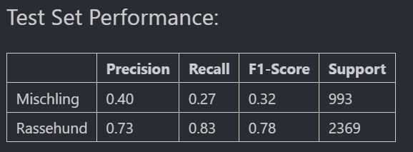
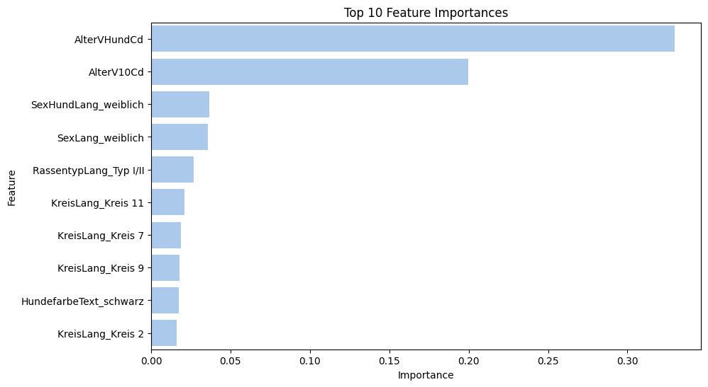
Model 2: Random Forest Classifier
RF Classifier: Modelling Approach
Random Forest Classifier with hyperparameter tuning (GridSearchCV)
Evaluated: Precision, Recall, F1 and Feature Importance of top-10 features
The model performs well for purebred dogs (Rassenhund) with an F1 score of 0.78, but poorly for mixed breeds (Mischling) with an F1 score of 0.32.
The most important feature is the dog's age, followed by the owner's age.

Slide 9
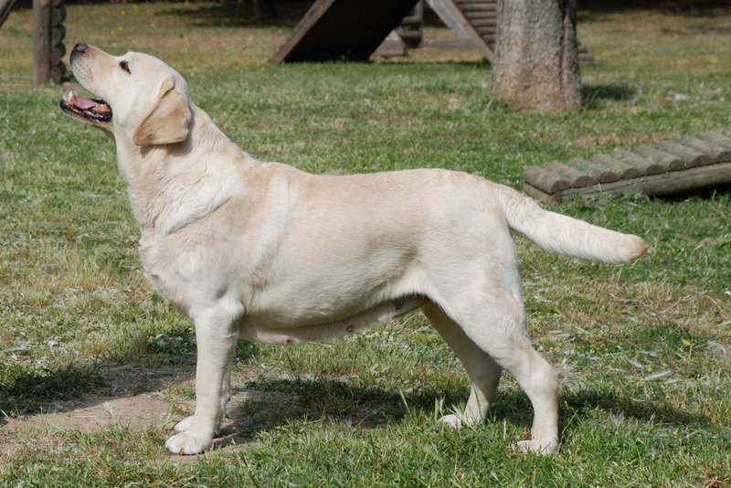
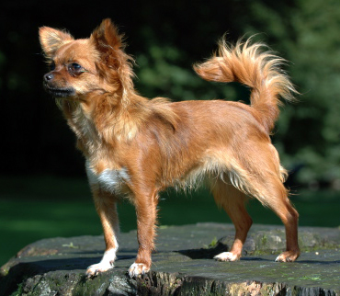
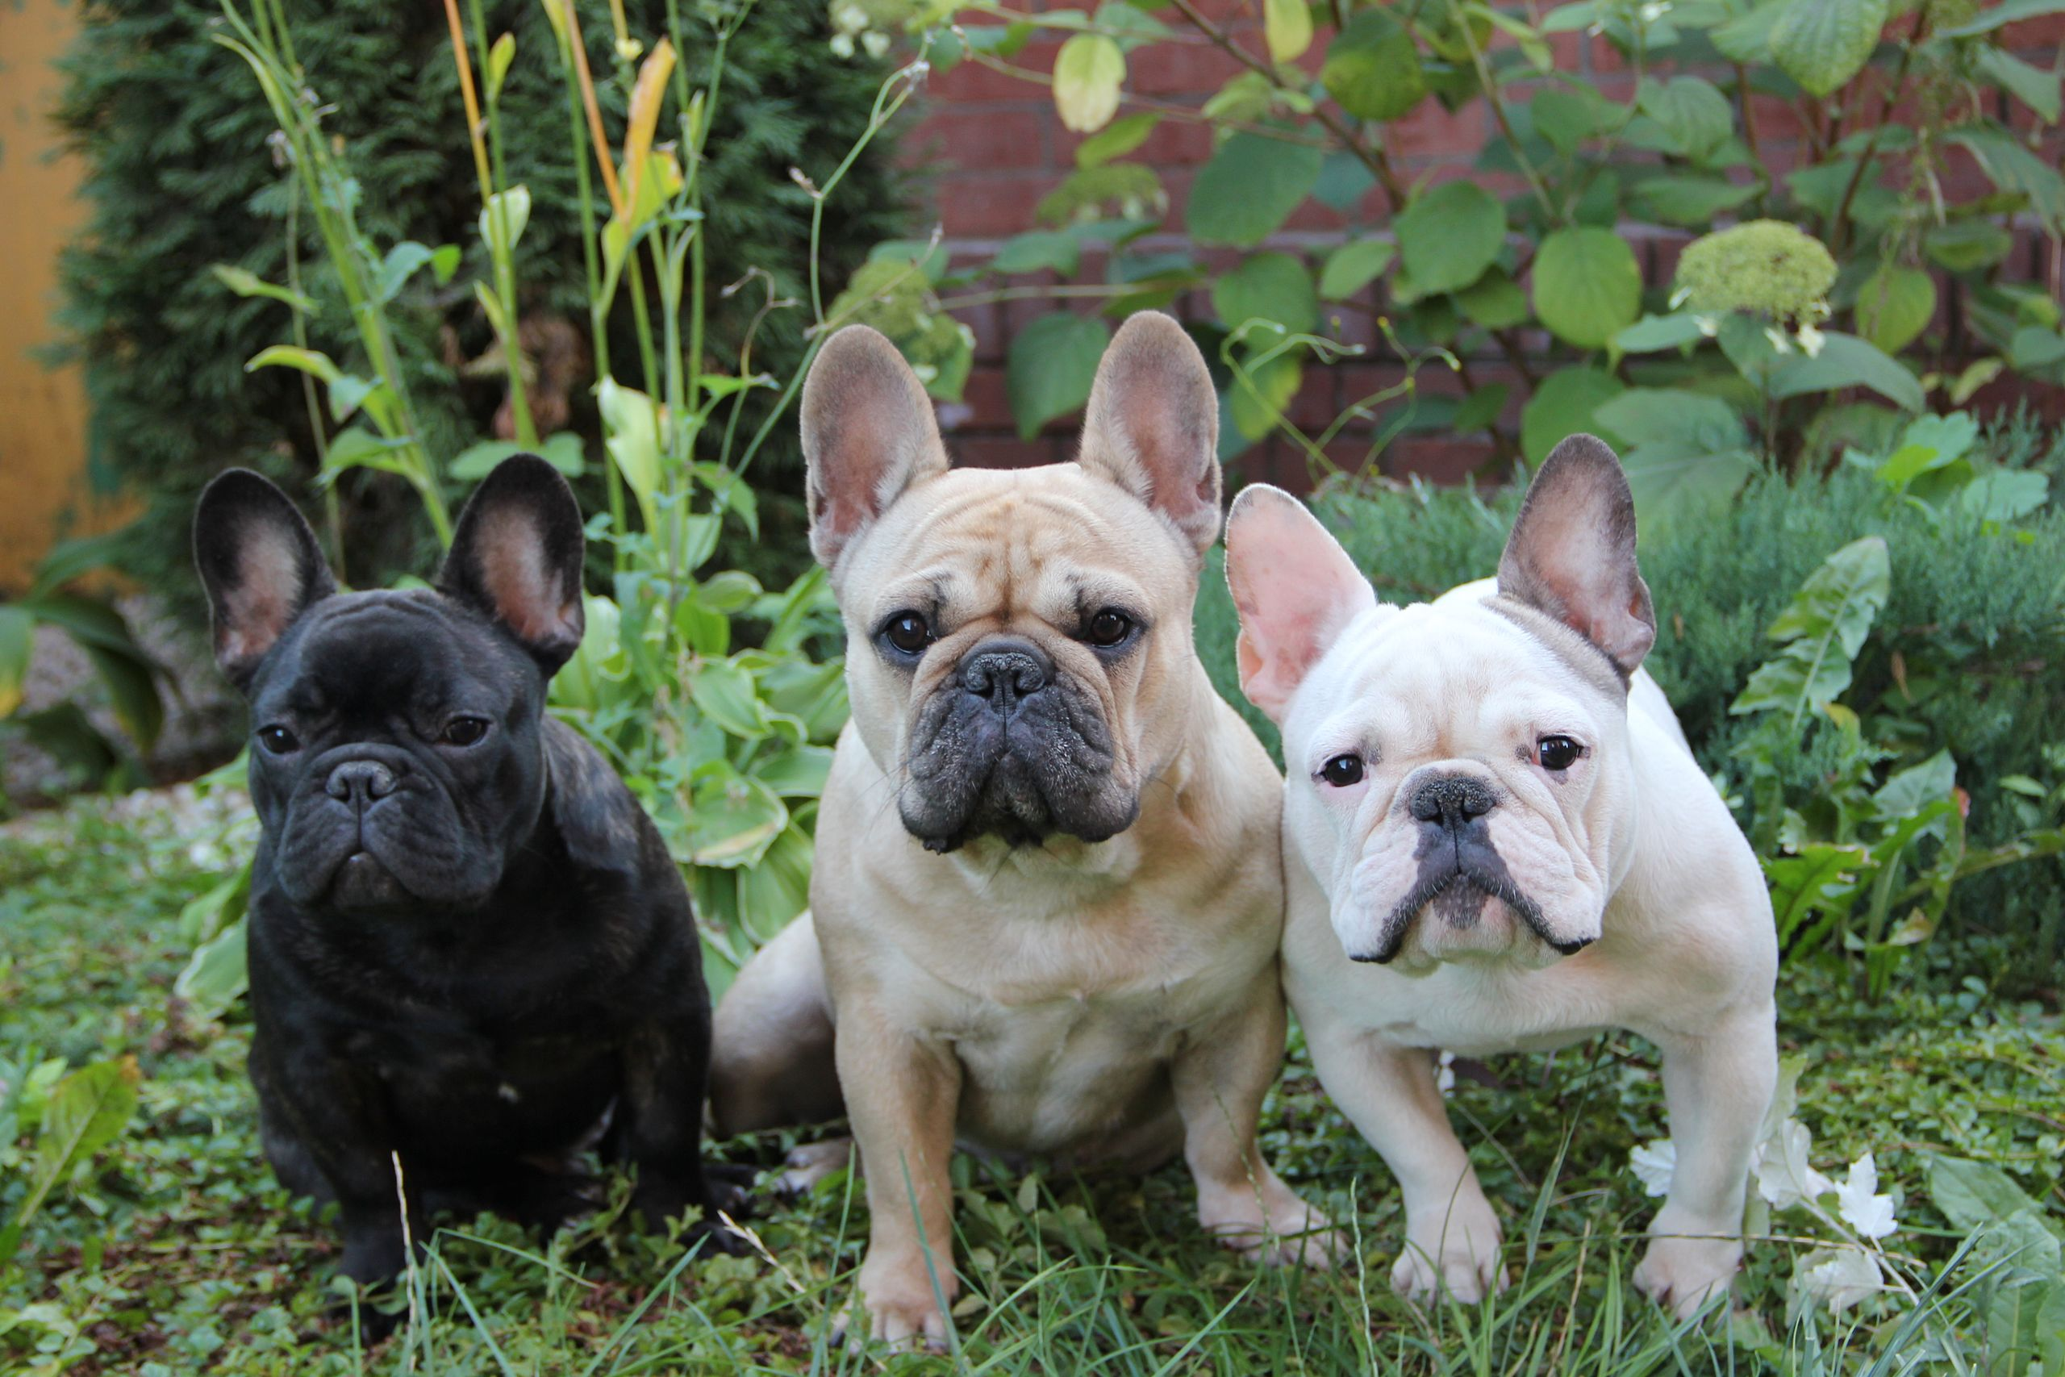
Conclusions – Moderate Performance; Further Improvements Possible
🥇
Final Remarks
Both models performed moderately for purebred dogs but poorly for mixed-breed dogs.
Random forest outperformed logistic regression overall.
Logistic regression highlighted dog type as the most important feature, while random forest focused on age and owner characteristics.
The shift to predicting purebred vs. mixed breed was due to the infeasibility of predicting exact breeds with the available data.
🥈
🥉
[1] https://commons.wikimedia.org/wiki/Labrador_Retriever#/media/File:Yellow_Labrador_Retriever_2.jpg
[2] https://commons.wikimedia.org/wiki/Chihuahua_(dog)#/media/File:Chihuahua1_bvdb.jpg
[3] https://commons.wikimedia.org/wiki/Category:French_Bulldog

